Slide 1
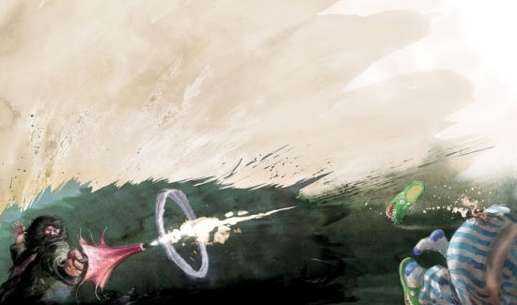
A Visualization
of the
The Spells
of the
Wizarding World
by Valerie Lemuth & Johanna Sacher
Artwork by Jim Kay - from the illustrated Harry Potter Novels, written by J.K.Rowling

Slide 2
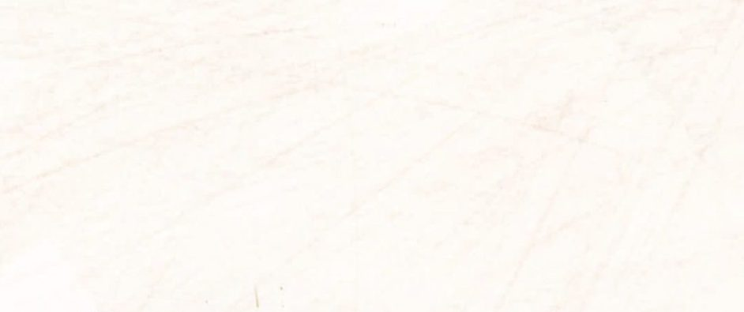
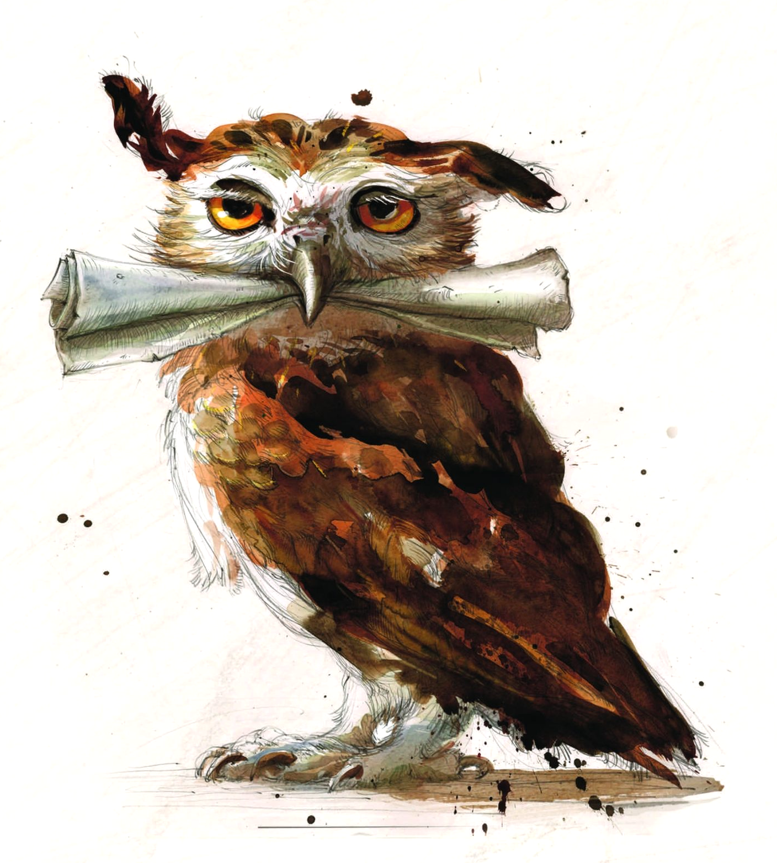
The Idea
The Spells of the Wizarding World
Valerie Lemuth & Johanna Sacher
Using the Spells of the Harry Potter Books
Notes:
First Idea was to use data we actually liked, so it was kind of obvious to go with Harry Potter
We thought it would be very interesting to learn more about the spells used in the books, for example

Slide 3
The Idea
The Spells of the Wizarding World
Valerie Lemuth & Johanna Sacher
Using the Spells of the Harry Potter Books
-> First introduction of each spell
-> Number of Uses
Notes:
when do they first occur?
how often are they used in each book and over all
->

Slide 4
The Idea
The Spells of the Wizarding World
Valerie Lemuth & Johanna Sacher
Using the Spells of the Harry Potter Books
-> First introduction of each spell
-> Number of Uses
-> Development of Advancement/Danger over time
Notes:
is there some kind of development in the used spells?
which lead to the Question:

Slide 5
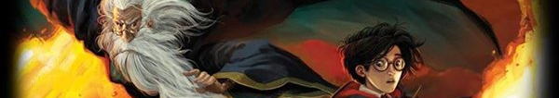
The Question
The Spells of the Wizarding World
Valerie Lemuth & Johanna Sacher
Is the number of used spells – and especially curses – increasing within the progress of the story?
Artwork by Jim Kay - from the illustrated Harry Potter Novels, written by J.K.Rowling
Notes:
Is the number of used spells, and especially curses or unforgivable curses, increasing within the progress of the story?
for example: are there more curses used, when Lord Voldemort returns?
and is there a greater variety of spells when the world becomes more dangerous?

Slide 6
Creating the Data
The Spells of the Wizarding World
Valerie Lemuth & Johanna Sacher
Nothing suitable on the web
Notes:
We did not find a dataset with everything we needed, so we decided to create one ourselves:

Slide 7
Creating the Data
The Spells of the Wizarding World
Valerie Lemuth & Johanna Sacher
Nothing suitable on the web
Created dataset ourselves
-> Using Python and prior knowledge of the material
Notes:
first we collected a list of all spells and sorted it by hand
then we gathered all the Harry Potter Books as txt files and searched them for the spells using python
the dataset then looked like this:

Slide 8
The Dataset
The Spells of the Wizarding World
Valerie Lemuth & Johanna Sacher
Key
-> Spell
Notes:
The Key is the Spell
and the Values are: ->

Slide 9
The Dataset
The Spells of the Wizarding World
Valerie Lemuth & Johanna Sacher
Key
-> Spell
Values
-> Number of occurrences per book
-> Effect
-> Type
-> Category
-> Danger
-> Link for further information
Notes:
Number of occurrences per book
Effect
Type (Charm, Spell, Curse, Unforgivable Curse)
Category
Danger (Harmless, Harmful, Severe, Lethal)
and a Link for further Information
from this we build an html-page with all the spells and then started creating the visualization with javascript and d3

Slide 10
The Layout
The Spells of the Wizarding World
Valerie Lemuth & Johanna Sacher
Headline
List
of Spells
Main Visu
Notes:
This was our layout and we decided on using two basic elements:
a list containing all the spells
-> because the are 80 spells and we wanted to provide an easy accessible overview
a diagram which serves as the main visualization
-> After experimenting a bit we decided to use an arc diagram: ->

Slide 11

The Layout | Arc Diagram
The Spells of the Wizarding World
Valerie Lemuth & Johanna Sacher
Notes:
Which looks like this ->

Slide 12
The Layout | Arc Diagram
The Spells of the Wizarding World
Valerie Lemuth & Johanna Sacher
Feeling of a “connected timeline”
-> Links between circles provide clear overview
Notes:
as you can see, it provides the feeling of a timeline
but the cool thing is that you kind of have a “connected” timeline with links between all the same items which appear at different times

Slide 13
The Layout | Arc Diagram
The Spells of the Wizarding World
Valerie Lemuth & Johanna Sacher
Feeling of a “connected timeline”
-> Links between circles provide clear overview
-> Temporal development of spells and use
Notes:
so it’s easier to see the development of the Use of a Spell over time

Slide 14
The Layout | Arc Diagram
The Spells of the Wizarding World
Valerie Lemuth & Johanna Sacher
Feeling of a “connected timeline”
-> Links between circles provide clear overview
-> Temporal development of spells and use
-> Number of uses by size
Notes:
each item is a node
and the number of occurrences is encoded by the size of the node

Slide 15
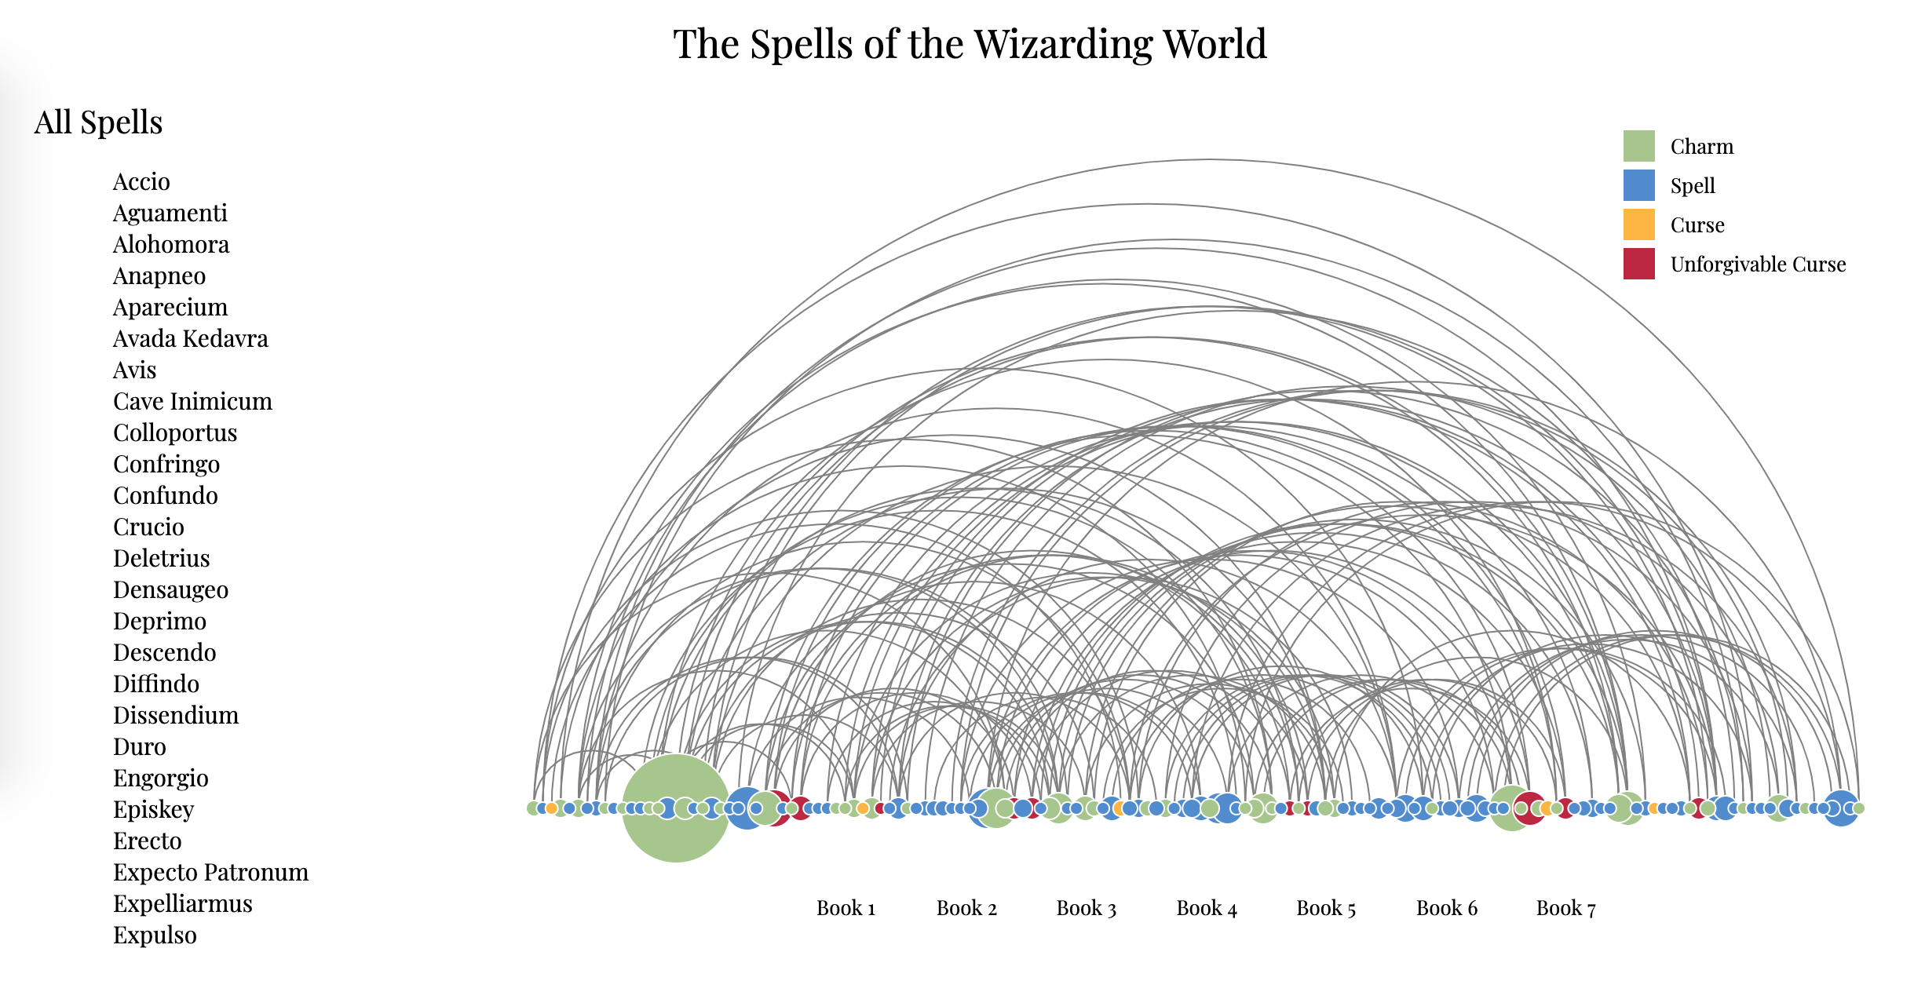
The Layout
The Spells of the Wizarding World
Valerie Lemuth & Johanna Sacher
Notes:
so this is what we did in the end and I’ll just walk you through the elements really quick

Slide 16
The Layout | List
The Spells of the Wizarding World
Valerie Lemuth & Johanna Sacher
All spells from the books
Scrollable
Alphabetically sorted
Headline shows selected filters
Notes:
The List on the left is scrollable and contains all the spells from all the books
they are alphabetically sorted
and the headline shows which filters were selected

Slide 17
The Layout | Timeline
The Spells of the Wizarding World
Valerie Lemuth & Johanna Sacher
All spells from 1. to 7. book
Each spell in a book = 1 Circle
Size = Number of uses
Color = Type
Connections between all occurrences of a spell
Notes:
The Timeline as well contains all the spells but here they may appear multiple times
as they have one node for each book they appear in
as said before, the size of each node indicates the number of uses in the respective book
and the color encodes the type of the spell:

Slide 18
The Layout | Legend
The Spells of the Wizarding World
Valerie Lemuth & Johanna Sacher
4 Types of Spells
-> For filtering
Notes:
There are four Types: Charm, Spell, Curse and Unforgivable Curse
They can be selected in the legend on the top right to set a filter and to only show spells of that type

Slide 19
The Layout | Books
The Spells of the Wizarding World
Valerie Lemuth & Johanna Sacher
All 7 Books
-> For filtering
-> Shows the idea of the timeline, but is not aligned
-> Would be too cramped
Notes:
lastly there are the booklabels,
here we see all 7 books, so you can filter for spells of a specific book
they support the idea of the timeline above
but are not aligned with it, as that would be way to crowded
there are much too few spells in the first books and too many in the last ones - the names would overlap and make reading and interactions impossible

Slide 20
The Visualization
The Spells of the Wizarding World
Valerie Lemuth & Johanna Sacher
Basic Interactions
Nested Interactions
Notes:
Now the whole Visualization and the possible interactions
What we have are basic and nested interactions
The basic interactions all work the same within the different components (Timeline, List, Legend, Books) >
You can hover above an element and get further information through a tooltip
You can click on an element to select and highlight it
And to deselect an element you click on the same one again
Important to note:
Clicking on one element of a specific component affects the elements of the other components, they either adapt to show corresponding information or they get filtered
This leads to the nested interactions
After clicking on an element of a component that filters, another element of a different component that also filters can be selected
That way multiple filters can be applied over another to basically narrow down the search for a specific spell, spell type or book
Now I’m going to show you this in the visualization so you get a better idea of what I mean

Slide 21
The Visualization
The Spells of the Wizarding World
Valerie Lemuth & Johanna Sacher
Basic Interactions
- Hover -> information through tooltip
Nested Interactions
Notes:
Now the whole Visualization and the possible interactions
The basic interactions all work the same within the different components (Timeline, List, Legend, Books)
You can hover above an element and get further information through a tooltip >
You can click on an element to select and highlight it
And to deselect an element you click on the same one again
Important to note:
Clicking on one element of a specific component affects the elements of the other components, they either adapt to show corresponding information or they get filtered
This leads to the nested interactions
After clicking on an element of a component that filters, another element of a different component that also filters can be selected
That way multiple filters can be applied over another to basically narrow down the search for a specific spell, spell type or book
Now I’m going to show you this in the visualization so you get a better idea of what I mean

Slide 22
The Visualization
The Spells of the Wizarding World
Valerie Lemuth & Johanna Sacher
Basic Interactions
- Hover -> information through tooltip
- Click -> select and highlight
Nested Interactions
Notes:
Now the whole Visualization and the possible interactions
The basic interactions all work the same within the different components (Timeline, List, Legend, Books)
You can hover above an element and get further information through a tooltip
You can click on an element to select and highlight it >
And to deselect an element you click on the same one again
Important to note:
Clicking on one element of a specific component affects the elements of the other components, they either adapt to show corresponding information or they get filtered
This leads to the nested interactions
After clicking on an element of a component that filters, another element of a different component that also filters can be selected
That way multiple filters can be applied over another to basically narrow down the search for a specific spell, spell type or book
Now I’m going to show you this in the visualization so you get a better idea of what I mean

Slide 23
The Visualization
The Spells of the Wizarding World
Valerie Lemuth & Johanna Sacher
Basic Interactions
- Hover -> information through tooltip
- Click -> select and highlight
- Click again -> deselect
Nested Interactions
Notes:
Now the whole Visualization and the possible interactions
The basic interactions all work the same within the different components (Timeline, List, Legend, Books)
You can hover above an element and get further information through a tooltip
You can click on an element to select and highlight it
And to deselect an element you click on the same one again >
Important to note:
Clicking on one element of a specific component affects the elements of the other components, they either adapt to show corresponding information or they get filtered
This leads to the nested interactions
After clicking on an element of a component that filters, another element of a different component that also filters can be selected
That way multiple filters can be applied over another to basically narrow down the search for a specific spell, spell type or book
Now I’m going to show you this in the visualization so you get a better idea of what I mean

Slide 24
The Visualization
The Spells of the Wizarding World
Valerie Lemuth & Johanna Sacher
Basic Interactions
- Hover -> information through tooltip
- Click -> select and highlight
- Click again -> deselect
-> Selecting an element affects the other components, they adapt or get filtered
Nested Interactions
Notes:
Now the whole Visualization and the possible interactions
The basic interactions all work the same within the different components (Timeline, List, Legend, Books)
You can hover above an element and get further information through a tooltip
You can click on an element to select and highlight it
And to deselect an element you click on the same one again
Important to note:
Clicking on one element of a specific component affects the elements of the other components, they either adapt to show corresponding information or they get filtered
This leads to the nested interactions >
After clicking on an element of a component that filters, another element of a different component that also filters can be selected
That way multiple filters can be applied over another to basically narrow down the search for a specific spell, spell type or book
Now I’m going to show you this in the visualization so you get a better idea of what I mean

Slide 25
The Visualization
The Spells of the Wizarding World
Valerie Lemuth & Johanna Sacher
Basic Interactions
- Hover -> information through tooltip
- Click -> select and highlight
- Click again -> deselect
-> Selecting an element affects the other components, they adapt or get filtered
Nested Interactions
- Multiple filters can be applied over each other
-> To narrow down the search
Notes:
Now the whole Visualization and the possible interactions
The basic interactions all work the same within the different components (Timeline, List, Legend, Books)
You can hover above an element and get further information through a tooltip
You can click on an element to select and highlight it
And to deselect an element you click on the same one again
Important to note:
Clicking on one element of a specific component affects the elements of the other components, they either adapt to show corresponding information or they get filtered
This leads to the nested interactions
After clicking on an element of a component that filters, another element of a different component that also filters can be selected
That way multiple filters can be applied over another to basically narrow down the search for a specific spell, spell type or book
Now I’m going to show you this in the visualization so you get a better idea of what I mean

Slide 26
The Conclusion
The Spells of the Wizarding World
Valerie Lemuth & Johanna Sacher
Is the number of used spells – and especially curses – increasing within the progress of the story?
Artwork by Jim Kay - from the illustrated Harry Potter Novels, written by J.K.Rowling
Notes:
Now for the conclusion of our initial question we were trying to answer:
Is the number of used spells, and especially curses or unforgivable curses, increasing within the progress of the story?
is there a greater variety of spells when the world becomes more dangerous? >
→ Yes there is!

Slide 27
The Conclusion
The Spells of the Wizarding World
Valerie Lemuth & Johanna Sacher
Is the number of used spells – and especially curses – increasing within the progress of the story?
→ Yes!
Artwork by Jim Kay - from the illustrated Harry Potter Novels, written by J.K.Rowling
Notes:
Now for the conclusion of our initial question we were trying to answer:
Is the number of used spells, and especially curses or unforgivable curses, increasing within the progress of the story?
is there a greater variety of spells when the world becomes more dangerous? >
→ Yes there is!

Slide 28
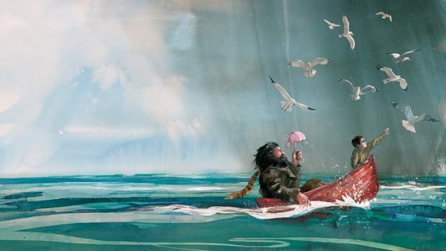
Thank you!
The Spells of the Wizarding World
by Valerie Lemuth & Johanna Sacher
Artwork by Jim Kay - from the illustrated Harry Potter Novels, written by J.K.Rowling

